Slide 1

Housing Price Prediction

Slide 2
Introduction
Data Loading and data Description
Data Understanding and Exploration
Data cleaning
Feature Engineering & Improving data quality
Splitting data into training and evaluation sets
Feature Scaling
Model building and
Evaluation

Slide 3
Goals
There are two primary goals of this assignment.
Statistical and exploratory data analysis of housing prices.
And to create machine learning models that can predict the housing prices.

Slide 4
Importing Packages
Numpy - Implementing multi-dimensional array and matrices.
Pandas - For data manipulation and analysis.
Matplotlib - Plotting library for Python programming language and it's numerical mathematics extension NumPy.
Seaborn - Provides a high level interface for drawing attractive and informative statistical graphics.
Scikit-learn - Scikit-learn is a free software machine learning library for the Python programming language. It features various classification, regression and clustering algorithms including support vector machines, random forests, gradient boosting, k-means and DBSCAN, and is designed to interoperate with the Python numerical and scientific libraries NumPy and SciPy.

Slide 5
Initial observations
This dataset has 1460 rows and 81 columns.
Summary of data types in this dataset:
Numeric: 3 (Float), 35 (Integer)
Object: 43
The following variables have null and zero values that may need to addressed.
PoolQC has 1453 missing values.
MiscFeature has 1406 missing values.
Alley has 1369 missing values.
Fence has 1179 missing values.
FireplaceQu has 690 missing values.
LotFrontage has 259 missing values.
GarageCond has 81 missing values.

Slide 6
Initial observations
GarageType has 81 missing values.
GarageYrBlt has 81 missing values.
GarageFinish has 81 missing values.
GarageQual has 81 missing values.
BsmtExposure has 38 missing values.
BsmtFinType2 has 38 missing values.
BsmtFinType1 has 37 missing values.
BsmtCond has 37 missing values.
BsmtQual has 37 missing values.
MasVnrArea has 8 missing values.
MasVnrType has 8 missing values.
Electrical has 1 missing values.

Slide 7
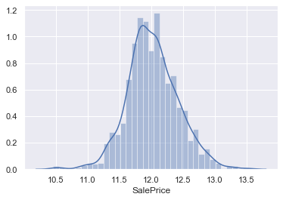
Final observations
It appears that the target, SalePrice, is very skewed and a transformation like a logarithm would make it more normally distributed. Machine Learning models tend to work much better with normally distributed targets, rather than greatly skewed targets. By transforming the prices, we can boost model performance.
Skewness: 1.882876
Kurtosis: 6.536282
sns.distplot(np.log(df["SalePrice"]))

Slide 8
Data Cleaning
In the context of data science and machine learning, data cleaning means filtering and modifying your data such that it is easier to explore, understand, and model. Filtering out the parts you don't want or need so that you don't need to look at or process them.
Removed PoolQC, MiscFeature, Alley, Fence and FireplaceQu columns as these are having very high missing data.
Filling missing data with mean / mode of their respective column
Filled LotFrontage, GarageYrBlt and MasVnrArea columns with mean value.
Filled GarageType, GarageFinish, GarageQual, GarageCond, BsmtFinType2, BsmtExposure, BsmtFinType1, BsmtQual, MasVnrType and Electrical columns with mode value.
Finding and removing outliers with following ranges
Column MSSubClass has upper bound - 145.0 and lower bound - 20

Slide 9
Data Cleaning
Column LotFrontage has upper bound - 107.5 and lower bound - 21.0
Column LotArea has upper bound - 17673.5 and lower bound - 1300
Column MasVnrArea has upper bound - 410.625 and lower bound - 0.0
Column BsmtFinSF1 has upper bound - 1780.625 and lower bound - 0
Column BsmtUnfSF has upper bound - 1685.5 and lower bound - 0
Column TotalBsmtSF has upper bound - 2052.0 and lower bound - 0
Column 1stFlrSF has upper bound - 2155.125 and lower bound - 334
Column 2ndFlrSF has upper bound - 1820.0 and lower bound - 0
Column LowQualFinSF has upper bound - 0.0 and lower bound - 0
Column GrLivArea has upper bound - 2747.625 and lower bound - 334

Slide 10
Data Cleaning
Column GarageArea has upper bound - 938.25 and lower bound - 0
Column WoodDeckSF has upper bound - 420.0 and lower bound - 0
Column OpenPorchSF has upper bound - 170.0 and lower bound - 0
Column SalePrice has upper bound - 13.021682213395525 and lower bound - 10.460242108190519

Slide 11
Feature Engineering
Feature engineering is the process of transforming raw data into features that better represent the underlying problem to the predictive models, resulting in improved model accuracy on unseen data.
Feature engineering turn your inputs into things the algorithm can understand.
Removed high correlated columns 1stFlrSF, TotRmsAbvGrd and GarageArea.
Removed irrelevant Id column.
Encoded columns MSZoning, LotShape and LandContour with one hot encoding.
Encoded columns Street, Utilities, LotConfig, LandSlope, BldgType, RoofStyle, BsmtFinType1, BsmtFinType2, Heating, Electrical, Functional, GarageFinish, PavedDrive, SaleCondition, ExterQual, ExterCond, BsmtQual, BsmtCond, HeatingQC, KitchenQual, GarageQual, GarageCond, Neighborhood, Condition1, Condition2, HouseStyle, RoofMatl, Exterior1st, Exterior2nd, MasVnrType, Foundation, GarageType and SaleType with Label encoding.

Slide 12
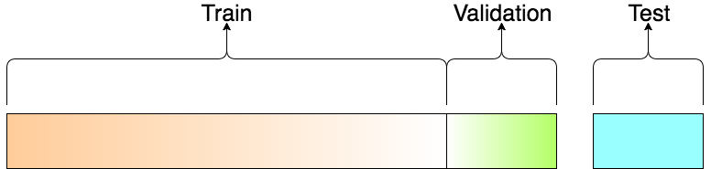
Splitting Data
The data we use is usually split into training data and test data.
Training Dataset: The sample of data used to fit the model.
Validation Dataset: The sample of data used to provide an unbiased evaluation of a model fit on the training dataset while tuning model hyperparameters. The evaluation becomes more biased as skill on the validation dataset is incorporated into the model configuration.
Test Dataset: The sample of data used to provide an unbiased evaluation of a final model fit on the training dataset.

Slide 13
Splitting Data
# separating our independent and dependent variable
X = dataframe.drop(['SalePrice'], axis=1)
y = dataframe["SalePrice"]
from sklearn.model_selection import train_test_split
x_train, x_test, y_train, y_test = train_test_split(X, y, random_state=1, test_size=.20)

Slide 14
Feature Scaling
Feature Scaling is a technique to standardize the independent features present in the data in a fixed range. It is performed during the data pre-processing to handle highly varying magnitudes or values or units. If feature scaling is not done, then a machine learning algorithm tends to weigh greater values, higher and consider smaller values as the lower values, regardless of the unit of the values.
Consider the two most important ones:
Min-Max Normalization
Standardization
# Feature Scaling
from sklearn.preprocessing import StandardScaler
sc = StandardScaler()
X_train = sc.fit_transform(x_train)
X_test = sc.transform(x_test)

Slide 15
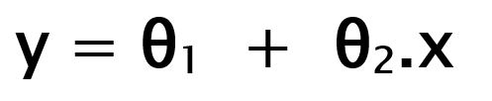
Building the Model
Linear Regression is a machine learning algorithm based on supervised learning. It performs a regression task. Regression models a target prediction value based on independent variables. It is mostly used for finding out the relationship between variables and forecasting. Different regression models differ based on – the kind of relationship between dependent and independent variables, they are considering and the number of independent variables being used.
While training the model we are given : x: input training data (univariate – one input variable(parameter)) y: labels to data (supervised learning)
When training the model – it fits the best line to predict the value of y for a given value of x. The model gets the best regression fit line by finding the best θ1 and θ2 values. θ1: intercept θ2: coefficient of x.

Slide 16


Building the Model
Once we find the best θ1 and θ2 values, we get the best fit line. So when we are finally using our model for prediction, it will predict the value of y for the input value of x.
# Linear Regression
from sklearn.linear_model import LinearRegression
linreg = LinearRegression()
linreg.fit(X_train,y_train)
### Prediction
y_pred_train = linreg.predict(X_train)
pred = pd.DataFrame(y_pred_train)
y_pred_test = linreg.predict(X_test)
pred_test = pd.DataFrame(y_pred_test)

Slide 17
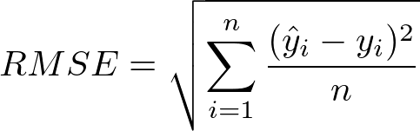
Model Evaluation Metrics
Model evaluation aims to estimate the generalization accuracy of a model on future (unseen/out-of-sample) data. Methods for evaluating a model's performance are divided into 2 categories: namely, holdout and Cross-validation. Both methods use a test set (i.e data not seen by the model) to evaluate model performance.
Root Mean Square Error (RMSE) is a standard way to measure the error of a model in predicting quantitative data.
Formally it is defined as follows:
RMSE: Root Mean Square Error is the measure of how well a regression line fits the data points. RMSE can also be construed as Standard Deviation in the residuals.

Slide 18
Model Evaluation Metrics
RMSE: Root Mean Square Error is the measure of how well a regression line fits the data points. RMSE can also be construed as Standard Deviation in the residuals.
### RMSE Metrics
from sklearn import metrics
# Calculated Train RMSE
calculated_train_rmse = np.sqrt(metrics.mean_absolute_error(y_train, y_pred_train))
print('Calculated Train RMSE is {}'.format(calculated_train_rmse))
# Calculated Test RMSE
calculated_test_rmse = np.sqrt(metrics.mean_absolute_error(y_test, y_pred_test))
print('Calculated Test RMSE is {}'.format(calculated_test_rmse))
Calculated Train RMSE is 0.297564606281447
Calculated Test RMSE is 0.29502104938445906

Slide 19
Model Evaluation Metrics
R-squared is a statistical measure of how close the data are to the fitted regression line. It is also known as the coefficient of determination, or the coefficient of multiple determination for multiple regression.
The definition of R-squared is fairly straight-forward; it is the percentage of the response variable variation that is explained by a linear model. Or:
R-squared = Explained variation / Total variation
R-squared is always between 0 and 100%:
0% indicates that the model explains none of the variability of the response data around its mean.
100% indicates that the model explains all the variability of the response data around its mean.
In general, the higher the R-squared, the better the model fits your data.
R2 shows how well terms (data points) fit a curve or line.

Slide 20
Model Evaluation Metrics
from sklearn.metrics import r2_score
# Calculated Train R-squared
calculated_train_r_squared = r2_score(y_train, y_pred_train)
print('Calculated Train R-squared is {}'.format(calculated_train_r_squared))
# Calculated Test R-squared
calculated_test_r_squared = r2_score(y_test, y_pred_test)
print('Calculated Test R-squared is {}'.format(calculated_test_r_squared))
Calculated Train R-squared is 0.8896102116033099
Calculated Test R-squared is 0.9093618210786856

Slide 21

Model Evaluation Metrics
Adjusted r-square is a modified form of r-square whose value increases if new predictors tend to improve model's performance and decreases if new predictors does not improve performance as expected.
Adjusted R2 also indicates how well terms fit a curve or line, but adjusts for the number of terms in a model. If you add more and more useless variables to a model, adjusted r-squared will decrease.
If you add more useful variables, adjusted r-squared will increase.
Adjusted R2 will always be less than or equal to R2.
The formula is:

Slide 22
Model Evaluation Metrics
where:
N is the number of points in your data sample.
K is the number of independent regressors, i.e. the number of variables in your model, excluding the constant.
Calculation of Adjusted Train R-Square: 1 - ((1 - calculated_train_r_squared) * (X_train.shape[0] - 1) / (X_train.shape[0] - X_train.shape[1] - 1)) ⇒ 0.8816154079868366
Calculation of Adjusted Test R-Square: 1 - ((1 - calculated_test_r_squared) * (X_test.shape[0] - 1) / (X_test.shape[0] - X_test.shape[1] - 1)) ⇒ 0.87585576441583

